Slide 1
Short Description:
This hands-on conversation centers on our 18-year development of low-cost, non-proprietary Physical Computing & Robotics courses. Ideal for new and experienced tech educators, successes and failures will be discussed. You’ll have access to all our curricular materials – including textbooks developed for the course – and have time to code Arduino-compatible robotics platforms.
Extended description:
“STEAM” is a well-known buzz word in education today. Most schools have no problem satisfying the Science, Art, and Math portions of the acronym, but often struggle to include Technology and Engineering into the equation. Perhaps the biggest hurdle is finding a coherent curriculum that integrates them all while maintaining the thoroughness deserving of each discipline. This conversation describes the 18-year development of the Physical Computing & Robotics (PC&R) curriculum at a grades 9-12 school in Bucks County, PA. We will explain why the popular FIRST, LEGO, and VEX platforms did not fit within our long-range goals, and how a PC&R program can be started at a cost of roughly $200 per robotic platform and maintained with potentially no annual cost. We will share our successes and failures and hope that others will do the same.
Participants will have time to write code to control non-proprietary, Arduino-compatible microcontrollers and robots. These devices paved the way for the development of textbooks and a curriculum that integrates art, science, mathematics, and engineering under the technology envelope. Participants will be given access to all the textbooks and curricular materials developed for our PC&R course, as well as a list of tools, laboratory equipment, and supplies that keeps costs low while providing every student with their own scalable, autonomous robotics platform. For those who are just starting a robotics program and for those who would like to augment their existing program, we hope to foster discussions regarding which devices are considered indispensable, which are desirable, and which are luxuries.
Notes:
A reminder of what we said we would discuss today. Just to keep us honest.

Slide 2
Best Practices for Budget-Conscious, Non-Proprietary Physical Computing & Robotics Courses
Chris d. Odom: codom@georgeschool.org
Brian Patton: bpatton@georgeschool.org
Howard M. GlassEr: hglasser@georgeschool.org
George School
EduCon Designing the Future Workshop
1.25.20
www.pcrduino.com/workshops/
Notes:
Introductions. And we are very pleased to be talking to you today about the 18-year evolution of our Physical Computing & Robotics course at George School

Slide 3
File Locations
Download this PowerPoint file here:
www.pcrduino.com/workshops/
Download our PC&R Curriculum files here:
www.pcrduino.com/resources/
Notes:
Feel free to download the PowerPoint if you want to take notes as we go. Or take notes on the physical copies.

Slide 4
About Chris: codom@georgeschool.org
Former atmospheric physicist and rocket scientist with NASA’s sounding rocket program.
George School teacher since 2002.
Passionate about education. Teaching for 30 years; from Middle School to Grad School.
Started writing code in 1982 after I saw the movie Tron.
Coding was an essential part of my BS, MS, and PhD work in experimental physics and astronomy. Never took a course.
Notes:
Never played a video game after that.
There were no classes at my school. In fact, I had the only computer at my school, which opened all kinds of opportunities for me.
I have never taken a computer course – was always ahead of where my schools were. 100% self taught. And it is doable in this field. In grad school, I did learn numerical modeling in my Math Methods course.
I prefer the energy of young students.

Slide 5
About Brian: bpatton@georgeschool.org
Former Associate Scientist at the Krannert Institute of Cardiology and Bristol-Myers Squibb (BMS)
Co-inventor of the “Subcutaneous Puncture Closure Device” still used in clinics world-wide.
Inventor of a “Expressive feature mechanism for animated characters and devices”
Educator who has taught science classes and labs from Elementary School through Grad School

Slide 6
About Howard: hglasser@georgeschool.org
Passionate educator who has taught middle school, high school, undergrads, and grad students
Background in equity issues in education, formative assessment, and ed tech
At George School I support colleagues with implementing innovative instructional practices and technology into their teaching

Slide 7
About You
Expert robotics teachers with a decade of experience looking to compare their methods and equipment with another’s.
Educators with some robotics experience who are looking to see what’s new or to ascertain if their path is still valid.
Teachers with little to no experience and are exploring what it takes to get into embedded controller education.
Teachers with little to no experience who were forced to attend by your school.
Notes:
We imagine that we have people in the audience who are …
Hopefully, it is not the latter, but ironically, it is why we started down this path.

Slide 8
Brief (Optional) Introductions
Personal info
Experience/comfort level
About your students/school/program
Why are you here?
What computer platform (PC, Mac, Chromebook, Linux)?
What robotic platform if any?
Notes:
Re-organize according to experience/comfort?

Slide 9
Some Assumptions
You will stop us and ask questions as we go!
When we say “robotics” we also mean engineering, embedded controller programming, mechanical engineering, electronics, fabrication, and design. We will use it as a catch-all term for these individual disciplines.
Few schools have a comprehensive robotics program.
Many schools have a robotics club.
Few schools have a fully-equipped robotics lab space.
School’s are hungry to build a cohesive STEM/STEAM program.
Notes:
Also time for Q&A at the end
But if you have a pressing Q, ask it!
It’s more fun that way.
Certainly stop us if we have said something that you don’t understand.
Agreed?
STEM is Science, Technology, Engineering, and Mathematics.
STEAM is STEM with Art.

Slide 10
Today’s Conversation Objectives
There is no way to cover everything (or hardly anything) today. (Our textbooks cover nearly 1000 pages.)
We hope to start a dialog and meet like-minded people who share our excitement for STEAM education.
We want to share how we have used the power and possibilities of physical computing and embedded controller systems at George School.
If we can be a resource, then great!
We hope you will be a resource for us!

Slide 11
About George School
Quaker grades 9-12. Deliberate education of the whole person.
International. ~40 countries and ~20 states. Well Integrated.
Student body: Wide range of socio-economic backgrounds.
Boarding/Day: 55% board. Student time is highly constrained.
A liberal arts focus, with strong STEM/STEAM education. (2 Nobel Prize-winning scientists)
Robust AP and IB courses, with plenty of and non-AP and non-IB offerings.
Students are typically hardworking, creative, motivated, and kind.
As a result, most teachers stay for decades.

Slide 12
Technology @ George School
Definitely not a tech school.
Only 5% of students have any coding or engineering experience.
Student beginning technical skills are quite limited. But intelligent, creative, and quick to learn! Great artists!
Students must provide their own laptops. BYOL as of 2017.
Dual Platform: PC and Mac are fully supported.
Warning: It is increasingly difficult to find emerging tech apps for a Mac. Cloud-based solutions are popping up.
Notes:
Just so you know what kind of students we teach… Until recently, the school provided laptops for every classroom.
Mac issues: Some things work well: programming. Some work so-so: CAD, PCB fabrication. Some don’t work at all: Laser cutting

Slide 13
Evolution of GS Robotics: Beginnings
2002 – Chris’ first year at George School.
One computer science class:
Desktop Business Computing with Visual Basic.Net (VB.Net)
6 students (understandably). One girl. One student of color.
Evolved from business computing to general coding with VB.Net:
Math, Science, Games, Sports, and, yes, Business apps
Notes:
Desktop computing

Slide 14
Evolution: Kylan Turner & Brian Patton
The lone female in that first class was a senior named Kylan Turner. Math was not her favorite subject and saw programming as the lesser of all other math evils.
At that same time, Brian Patton – substitute teacher and President of Patton Robotics, LLC – introduced Chris to his patented facially expressive robot ESRA, which could be controlled with VB.Net code.
Read Kylan’s story: www.pcrduino.com/wp-content/uploads/about/Kylan_Turner_Georgian05.pdf .
Notes:
Patton Robotics and Robodyssey Systems were one of the first educational robotics companies in the world.
Relate story of Kylan’s first interactions at U Pitt neuroscience. And her first paper. And Yale.
Distribute article http://www.pcrduino.com/wp-content/uploads/about/Kylan%20Turner%20web_v77n3december05%20p8-31.pdf

Slide 15
Evolution of GS Robotics: Kylan’s Influence
Kylan’s story has stuck with us because it was so impactful and became the inspiration for today’s GS Robotics program.
Project-based learning is incredibly powerful.
Recruit out-of-the-box, creative thinkers with open arms – even (especially) if they don’t fit the typical profile of a technology geek.
Coding opens doors that would remain firmly closed otherwise.
Solidified in us that “schooling should never get in the way of one’s education”! There are lots of ways to teach material.
The start of a long collaboration with Brian Patton.

Slide 16
Evolution: Directions
In 2003, with only one course at his disposal, Chris felt compelled to create a physical computing and robotics course, which would introduce students to a wide range of skills and a variety of content areas.
No curriculum was available.
No robotics platform checked all the boxes.
The course, the curriculum, and the hardware had to be created from scratch.
Notes:
Open to sophomores, juniors, and seniors who meet the math prerequisite (~ Algebra 2 or Geometry with Trigonometry).
The diversity of George School is reflected well in our courses, but there is always room for improvement.
No AP, IB, or other curriculum. Still no curriculum available except mine.

Slide 17
Evolution of GS Robotics: Our Desires
A year-long course (not a club). Open to all 9th-12th graders who meet the math prerequisite (Algebra 2 or Geometry with Trig).
Coverage of a wide range of topics, including coding, electronics, engineering, design, and robotics.
One robot per student. The robot must evolve with the course.
Real coding, real engineering for the real world. Off-the-shelf components; no proprietary equipment. No drag-and-drop coding.
Autonomous robotics – nothing remote controlled. Teach to the future.
Accessible to a wide range of students of varying abilities. Intermediate and Intensive levels.
Must be affordable due to a limited budget.
Notes:
The diversity of George School is reflected well in our courses, but there is always room for improvement.
No AP, IB, or other curriculum. Still no curriculum available except mine.
Only $4000 for all physics and robotics classes!

Slide 18
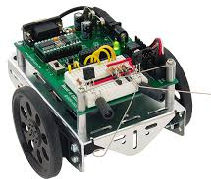
Evolution of GS Robotics: Robot Directions?
A lot of products were on the market, but which to choose? FIRST FRC, FIRST FTC, LEGO, BOE-BOT, VEX, OneBot?
These are all great, but after a much research and classroom testing, only one system ticked all our boxes: The OneBot robot with Teensy microcontroller brain and PRT motherboard. (The OneBot and PRT are creations of Patton Robotics, developed out of necessity.)
Want to know what factors went into our decision?
Notes:
See next slides for a list of the reasons as to why.

Slide 19
Robot Platforms: OneBot, LEGO, VEX, First, Boe-Bot
Needed expandable platform with infinite growth potential. (cf. LEGO, VEX, BOE-BOT)
Requires no proprietary (i.e. expensive) components. (cf. LEGO and VEX)
Requires real coding. A marketable skill. No drag and drop. (cf. LEGO and VEX (with Blocky))
Affordable. Allows for one student per robot. Students don’t have to fight for a chance to work on one big robot. (cf. FIRST and VEX)
DIY Kit. Fosters creation, not simply building. (cf. Boe-Bot)
Designed for autonomous robotics – not remote control. (cf. FIRST and LEGO)
Superior construction (durable aircraft aluminum, lots of mounting options). (cf. BOE-BOT and LEGO)

Slide 20
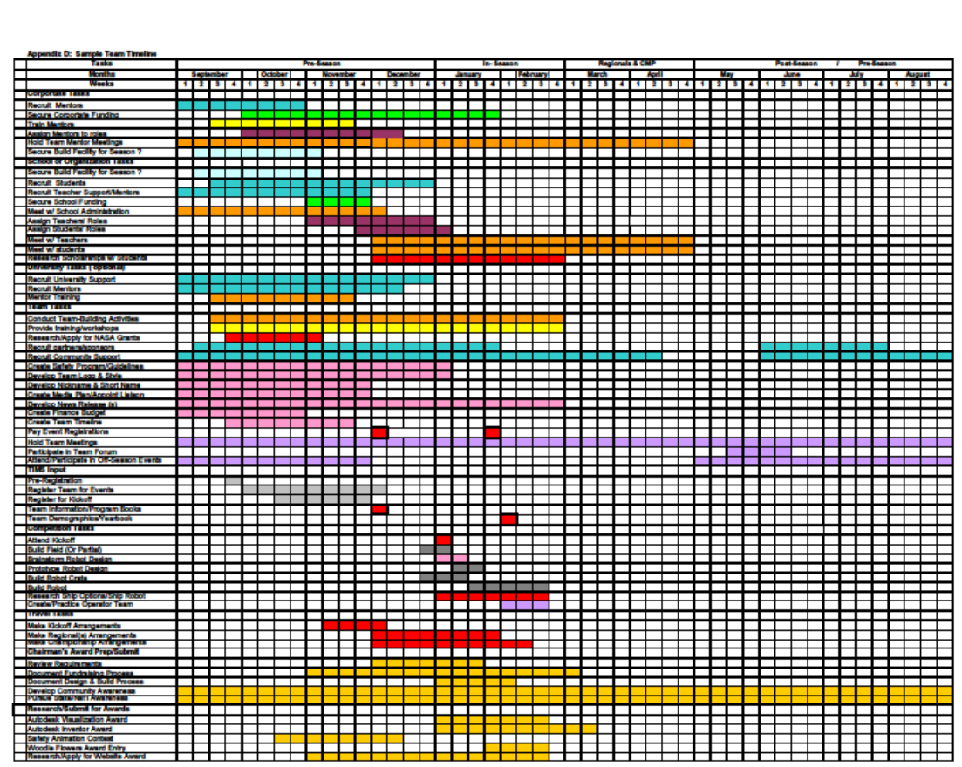
Evolution of GS Robotics: Why Not First
September 1
August 31
Expense $5K-$10k per year.
One big robot means non-shared experiences.
No room for the timid.
Too little time on robotics.
Little autonomy.
Too much effort for too little ROI.
“Build robot” (7 weeks)
Notes:
Here’s a sample “Team Timeline”.
Robots are primarily RC controlled.

Slide 21
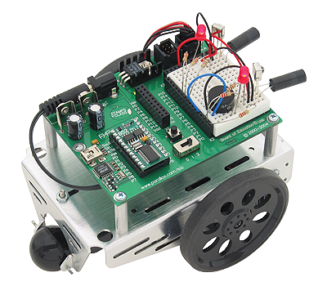
Evolution of GS Robotics: Why Not BOE-BOT?
BASIC Stamp is old processor with outdated technology
Not expandable. Robot does not evolve with the course.
Sheet metal chassis and plastic wheels; unlikely to hold up over time.
Notes:
BASIC Stamp – still used today!

Slide 22
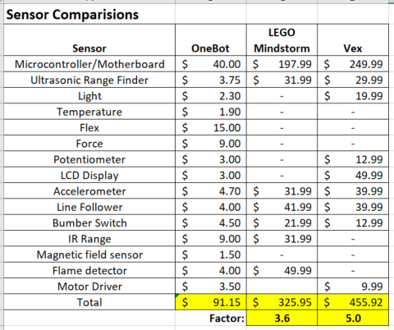
Evolution of GS Robotics: No VEX or LEGo?
Expensive. Sensors and Controllers cost 3.6-5.0 times more.
Proprietary hardware and software. Not real-world enough.
Limited expandability.
Limited number of available sensors.
www.pcrduino.com/wp-content/uploads/Workshops/sensor comparison.xlsx
Notes:
Here’s a sample “Team Timeline”.

Slide 23
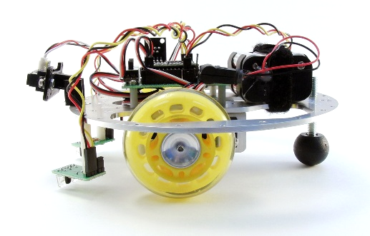
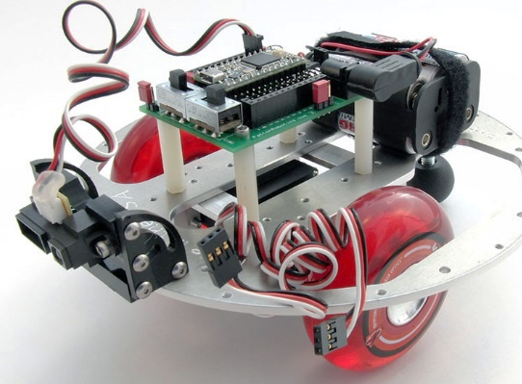
Evolution of GS Robotics: Why the OneBot?
No robot platform checked all our boxes. So OneBot educational platform from Patton Robotics was developed to check all our boxes.

Slide 24
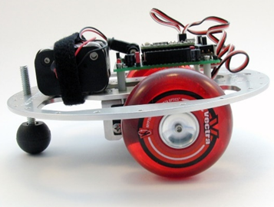
The OneBot Platform
It is robust. The aircraft aluminum chassis is practically indestructible.
It is versatile and expandable. Many pre-drilled thru and tapped holes makes it easy to mount lots of boards, sensors, motors, and other devices.
It is inexpensive. Well-outfitted for $170 means each student gets one!
Notes:
Here it is assembled.

Slide 25
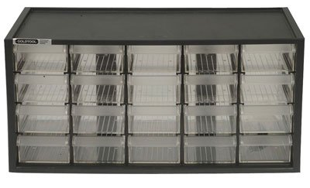
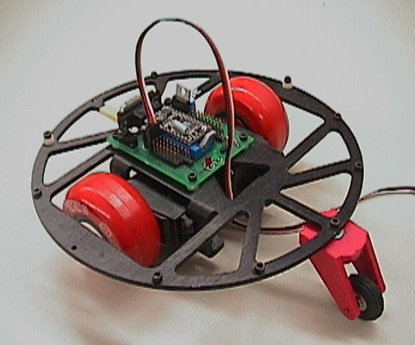
Evolution of GS Robotics: The Early Course
Started with 12 students and 6 loaner bots from Patton Robotics. We’d destroy them, they’d redesign them.
Only one box of electro-mechanical components.
Lecture-based, so all students moved at same pace. Not desirable!
Notes:
Students now responsible for providing their own laptops.
Moving at the same pace was nice! Teacher was in control. It was also bad pedagogy!
Chris used the same microcontroller in his research at Clemson, so he knew it well.
Today, enrollment in Robotics is at 50 students, or 700% increase.

Slide 26
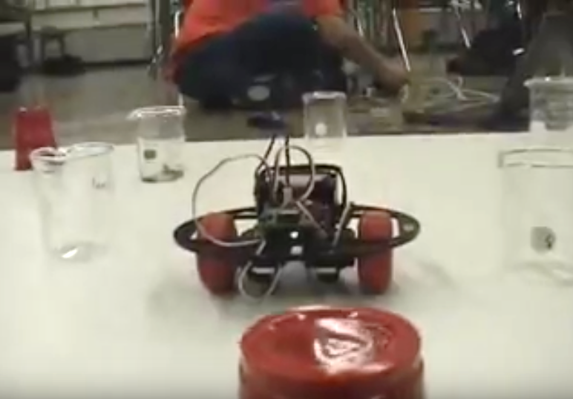
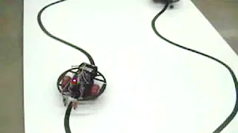
Evolution of GS Robotics: The Early Course
Not a lot of material covered in the early years – even in three terms. Limited by lecture style and speed of student group.
Primitive facilities, limited equipment, basic assignments, but great fun! (We didn’t know any better.) Students started pushing the envelope.
Lots of “dumb” dead-reckoning robots.
Course culminated with simple autonomous robot.
Early YouTube videos:
Robot Race: https://youtu.be/iv5yEhsUt94?t=4
Obstacle Course: https://youtu.be/cWlK8lbHUCA
Line Following: https://youtu.be/cjrybua2zKU
Notes:
Students now responsible for providing their own laptops.
Moving at the same pace was nice! Teacher was in control. It was also bad pedagogy!

Slide 27
Evolution of GS Robotics: The Early Course
Seen as “expensive” until we pointed out a classroom set of robots cost as much as one of the 18 computers in the cart. (About $170 per robot kit.)
Reusable, robust, and expandable robots. (Still in action today!)
Students shared robots (2 per bot).
Classes shared robots (1 set per 2 classes).
500% growth within 3 years! (2 classes, 32 students). Today we have 3 classes, 45 students + waiting list. (750% growth).
Initial investment has paid for itself 1000x over and spawned new courses (AP CS, A.I, Advanced Robotics, etc.) 15% of school. 1400% growth.

Slide 28
So much to cover, so little time …
What follows is a mere taste of the possibilities for students in the arena of programming, physical computing, and robotics.
You will begin with some hands-on skills using pre-programmed applications that will illuminate how to use logic to solve problems involving light from an LED and robot motion.
You will also play with a wide range of sensors and experiment with different ways to display sensor data.
We’ll dive into traditional programming topics.
We hope you will ask questions as we proceed!
Notes:
Also time for Q&A at the end
If you have a pressing Q, ask it! It’s more fun that way.
Certainly stop us if we have said something that you don’t understand.

Slide 29
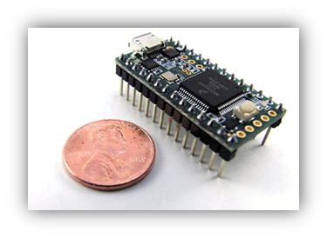
Examine Your robot: Teensy Microcontroller
Our preferred microcontroller is the Teensy 3.2, which is made in the USA by PJRC. It is the brain of your robot! You will program this popular 3.3-volt development board with a computer language called Arduino C using the Arduino IDE.
Small and fast ARM processor
Unbelievable math engine.
Inexpensive ($20) (pattonrobotics.com/products/teensy-3-2)
Uses EEPROM storage
Easily communicates with sensors, motors, LCDs, etc.
Notes:
Let’s examine some of the components on your robot…
9ns processing speeds!
3.3V system
EEPROM means the code remains even without power. No harddrive!
ARM = Advanced RISC Machines. (RISC = reduced instruction set computer)
Arduino C is a subset of C, C++, C#, and Java languages. It is a great beginner's language that easily ports to more complex languages.
every physical computing device is moving towards ARM and 3.3V. It will still be viable in ten years!

Slide 30
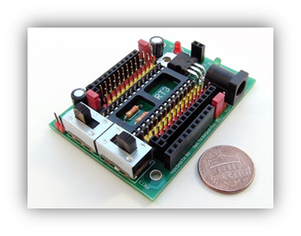
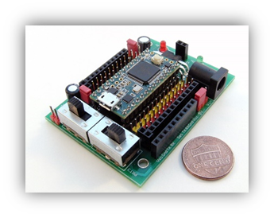
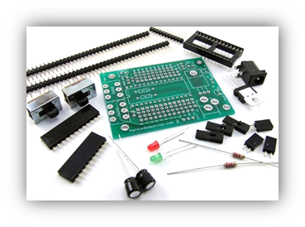
Examine Your robot: PRT_28 Motherboard
To facilitate communication with the Teensy, we will use the small PRT_28 motherboard made in the USA by Patton Robotics. The board was created out of necessity.
Inexpensive ($20) and robust. Field tested in space!
Sold pre-assembled or as a DIY kit. (Great soldering exercise for students!)
Easy communications between the Teensy, your computer, and all the sensors, motors, & plug-in devices.
Notes:
There is nothing this versatile on the market. We’ll compare it to other motherboards and breakout boards later in the talk.
Chris has launched it into space with a force of 20G’s.
Most schools buy it pre-assembled
Cannot overstate importance of easy, robust, and plentiful plug-n-play options! And power switches! And removable controller! And Male and Female header pins!

Slide 31
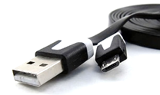
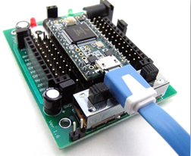
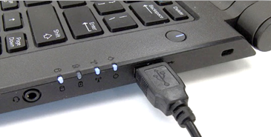
Examine Your robot: Programming Cable
A micro-B USB cable serves as the programming cable between your computer and the development board. (You probably have several of these around the house.)
It also allows the laptop’s USB port to power-up the Teensy and motherboard.

Slide 32
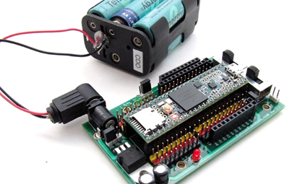
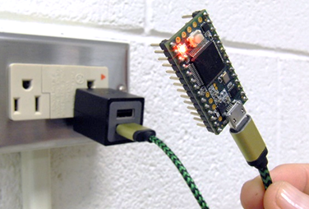
Examine Your robot: Battery Pack
Once code is sent from the laptop to the Teensy, the microcontroller can be unplugged from your computer.
A battery pack is then required to supply power to the Teensy and motherboard. (Typically, we use 6 NiMH AA’s.)
You can use lithium-batteries, 9V-batteries, a car battery, or even a phone charger to power the boards.
Notes:
Six rechargeable NiMH AA batteries provide 7.2V to the boards.

Slide 33
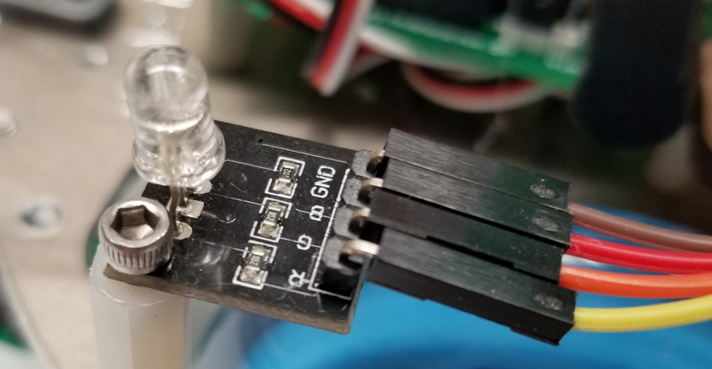
Examine Your robot: The Tri-Color (RGB) LED
On your robot, locate the tri-color LED. Inside the dome are three very tiny LEDs. (One red, one green, and one blue.)
This is also called an RGB LED for the Red, Green, and Blue colors it can make. It is possible to make over 16 million colors with these three LEDs! Let’s make a few right now!
Notes:
LED stands for Light-Emitting Diodes

Slide 34
Physical Computing: Desktop Computing on Steroids
Physical computing is about controlling devices other than a computer. Things like LEDs, buzzers, servomotors, DC motors, relays, LCD screens, and a wide array of sensors.
It requires a microcontroller (or development board) to handle the hand-shaking between the user’s code and the physical devices.
Microcontroller code is like the code written for desktop computers or mobile apps, but the microcontroller languages have additional commands to control physical devices.
Notes:
Desktop and laptop computers are interchangeable here.

Slide 35
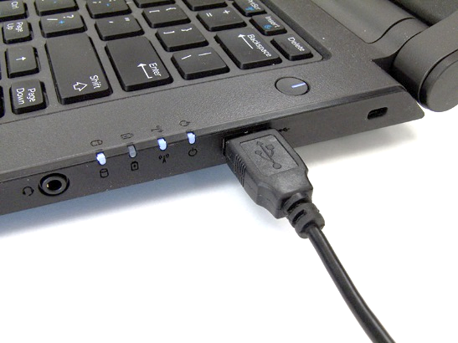
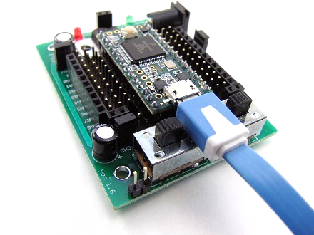
Coding the Embedded Controller
Code is written on the desktop/laptop computer using an Integrated Development Environment. We use the Arduino IDE (www.arduino.cc). (PC, Mac, and Linux)
The language is C-based. (Arduino C.)
To appeal to the artist in us all, programs are “sketches”.
Code is saved as a simple text file. New sketches start with a semi-blank page.
Code is compiled by the computer (via the IDE) and sent to the microcontroller via a cable. Because the computer does the compiling, the robot brain can be small, fast, and inexpensive.
Notes:
Arduino is a free download
IDE = Integrated Development Environment

Slide 36
“Computers never do what you want them to do, only what you tell them to do.”
Brian Patton
George School Robotics Teacher
President, Patton Robotics

Slide 37
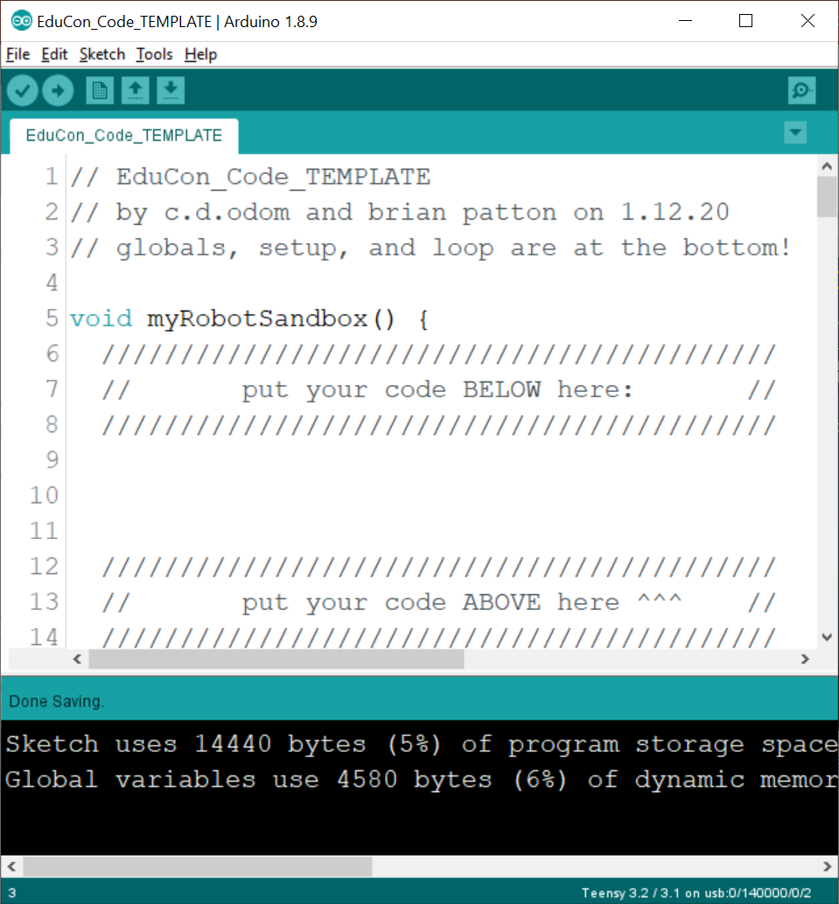
The Arduino IDE
The Arduino IDE (Integrated Development Environment) should be opened on your computer.
This is just a fancy name for an application that allows us to write code.
You should see this code in the code window →
Notes:
See https://www.arduino.cc/en/main/software to download the Arduino IDE.

Slide 38
Space for Your Code
On your computer, you will see the following lines of code:
void myRobotSandbox() {
///////////////////////////////////////////
// put your code BELOW here: //
///////////////////////////////////////////
///////////////////////////////////////////
// put your code ABOVE here ^^^ //
///////////////////////////////////////////
}
You will write ALL your code in the space indicated by the arrows.

Slide 39
Compile and Run the Code
Before you add any code, download the program onto the Teensy microcontroller by pressing [CRTL] + U, or by clicking the upload button:
WARNING! Only upload the code ONCE – do NOT double-click
NEVER unplug the microcontroller while it is uploading!
NEVER upload more code while it is uploading!
Be patient! Wait for the software to tell you the code has finished uploading!

Slide 40
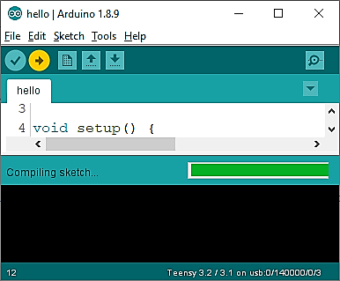
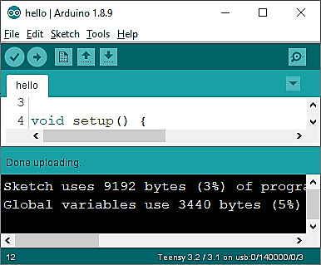
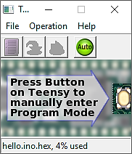
Upload Warnings!
WARNING! Only upload the code ONCE – do NOT double-click
NEVER unplug the microcontroller while it is uploading!
NEVER upload more code while it is uploading!
Be patient! Wait for the software to tell you the code has finished uploading!
Notes:
So important, I’ll say it twice!
It seems that some of these issues have been resolved recently for Teensy 3.2 users, as the new boards are now made in the USA. These seem to be more robust and less susceptible to the above issues.

Slide 41
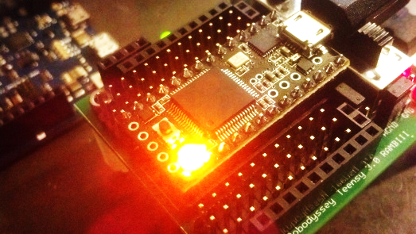
Is Everything OK?
If everything is working fine, you should see the Teensy’s onboard LED blink three times to say, “everything is OK”.

Slide 42
Coding the Controller – The Details
When you pressed the Upload button , your code was compiled into machine code by the computer via the Arduino IDE.
It is then uploaded to the microcontroller via a USB cable.
Once the machine code is loaded into the microcontroller, it can be executed repeatedly – no computer is necessary.
The code remains in the EEPROM (memory) of the microcontroller forever.
New code can be written and uploaded to the robot brain practically as many times as desired. Old code is overwritten.

Slide 43
An Illuminating Program
It’s your turn to write some code. In the appropriate space shown below, enter the command exactly as it is shown.
///////////////////////////////////////////
// put your code BELOW here: // ///////////////////////////////////////////
displayRGB(255, 0, 0);
///////////////////////////////////////////
// put your code ABOVE here ^^^ // ///////////////////////////////////////////
Compile the short program and note that the RGB LED now glows red! Have a light diffuser?
Notes:
Most code is case sensitive. Arduino C is no exception.

Slide 44
A Little Understanding of displayRGB()
The syntax for the homemade displayRGB() command is shown below. (Feel free to take notes.)
displayRGB(redValue, greenValue, blueValue);
The redValue, greenValue, and blueValue parameters are numbers that set how much red, green, and blue to make:
A value of 0 is no light.
A value of 255 is maximum brightness.
So displayRGB(255,0,0) makes a bright red light!
Notes:
This is not a built-in command. We made it just for you!
The Teensy controls how much color to make by altering how long the voltage is applied to each LEDs.

Slide 45
Green with Envy?
Now change the code to make only the green LED light up? Remember, it is an RGB LED. (Consider the order.)
///////////////////////////////////////////
// put your code BELOW here: // ///////////////////////////////////////////
displayRGB(0, 255, 0);
///////////////////////////////////////////
// put your code ABOVE here ^^^ // ///////////////////////////////////////////
///////////////////////////////////////////
// put your code BELOW here: // ///////////////////////////////////////////
displayRGB(???, ???, ???);
///////////////////////////////////////////
// put your code ABOVE here ^^^ // ///////////////////////////////////////////
Compile the code to see if your RGB LED now glows bright green!
Notes:
Remember, the device is an RGB LED.

Slide 46
Feeling a Little Blue?
What is the code to make only the blue LED light up?
///////////////////////////////////////////
// put your code BELOW here: // ///////////////////////////////////////////
displayRGB(0, 0, 255);
///////////////////////////////////////////
// put your code ABOVE here ^^^ // ///////////////////////////////////////////
///////////////////////////////////////////
// put your code BELOW here: // ///////////////////////////////////////////
displayRGB(???, ???, ???);
///////////////////////////////////////////
// put your code ABOVE here ^^^ // ///////////////////////////////////////////
Compile it to see if the RGB LED now glows blue!
Notes:
Remember, it is an RGB LED!

Slide 47
Additive Colors
In art class paint mixes with subtractive color:
Yellow paint mixed with cyan paint make green.
Yellow and magenta gives red.
If you mixed them all together you made black.
In physics class light mixes with additive color, as shown below:

Slide 48
Time to Explore!
Alter the displayRGB() command to make some of the following colors:
Yellow
Cyan
Magenta
White
Dim Magenta
Yellow = (255, 255, 0)
Cyan = (0, 255, 255)
Magenta = (255, 0, 255)
White = (255, 255, 255)
Dim Magenta = (50, 0, 50)
Notes:
Use what you know about the displayRGB() command and the additive color wheel to answer these.

Slide 49
Bright vs Dim Magenta?
It is difficult for the human eye to discern the difference, for example, between bright magenta:
displayRGB(255, 0, 255)
and dim magenta:
displayRGB(50, 0, 50)
when there is a significant time lag between the two.

Slide 50
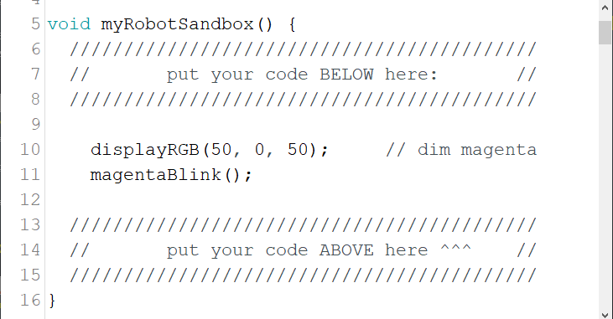
Call the magentaBlink() Function
To help us more easily see the difference between the two colors, call the magentaBlink() command like so:
Notes:
Don’t forget the semicolon!

Slide 51
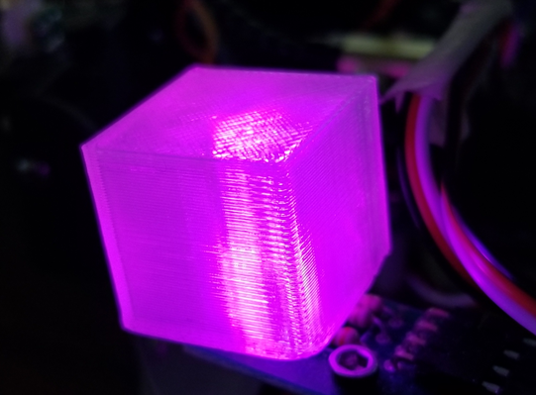
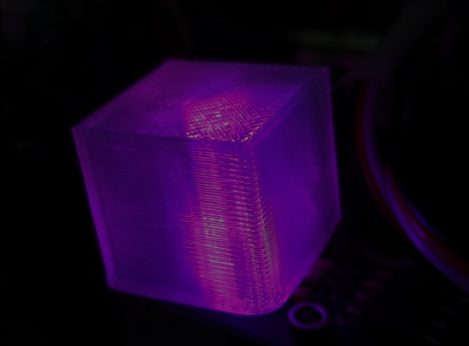
Upload the magentaBlink() Function
Upload the the magentaBlink() command to the microcontroller. You should see the RGB LED flash between bright magenta and dim magenta:
Notes:
So, what’s going on here? Let’s look at the code…

Slide 52
Locate the magentaBlink() Code
Find the magentaBlink() function, which can be found around line 90 near the bottom of your code:
Notes:
Let’s try to demystify these commands…

Slide 53
Create the magentaBlink() Function
The function is created with the void command and the name of the function, which is magentaBlink() for this case. The empty parentheses is required.
void magentaBlink() {
while (true) {
displayRGB(255, 0, 255); // bright magenta
delay(1000); // pause for 1s
displayRGB(50, 0, 50); // dim magenta
delay(1000); // pause for 1s
}
}
Notes:
The void keyword simply means the function returns nothing. It does something, but returns no value.

Slide 54
Code within magentaBlink()
All the code for the magentaBlink() function must be contained within the curly braces highlighted below:
void magentaBlink() {
while (true) {
displayRGB(255, 0, 255); // bright magenta
delay(1000); // pause for 1s
displayRGB(50, 0, 50); // dim magenta
delay(1000); // pause for 1s
}
}

Slide 55
A While-Loop Inside magentaBlink()
The while(true) command is a repeating structure that loops repeatedly while the conditional statement in parentheses is true. Because true is always true, the loop never ends!
All the code in the while-loop must live between its curly braces.
void magentaBlink() {
while (true) {
displayRGB(255, 0, 255); // bright magenta
delay(1000); // pause for 1s
displayRGB(50, 0, 50); // dim magenta
delay(1000); // pause for 1s
}
}

Slide 56
Illuminate the LED within magentaBlink()
Within the while-loop, the familiar code to makes the tri-color LED display a bright magenta color…
… and another command makes a dim magenta color.
void magentaBlink() {
while (true) {
displayRGB(255, 0, 255); // bright magenta
delay(1000); // pause for 1s
displayRGB(50, 0, 50); // dim magenta
delay(1000); // pause for 1s
}
}
void magentaBlink() {
while (true) {
displayRGB(255, 0, 255); // bright magenta
delay(1000); // pause for 1s
displayRGB(50, 0, 50); // dim magenta
delay(1000); // pause for 1s
}
}

Slide 57
pauses create blinks in magentaBlink()
Two delay() commands are used to pause the execution of the code for 1000 milliseconds so the human eye can register the different colors. (1000 milliseconds = 1 second)
void magentaBlink() {
while (true) {
displayRGB(255, 0, 255); // bright magenta
delay(1000); // pause for 1s
displayRGB(50, 0, 50); // dim magenta
delay(1000); // pause for 1s
}
}

Slide 58
comment the magentaBlink() Code
Finally, we can add some comments to the code to make the code easier to understand. These comments are ignored by the microcontroller, but are invaluable to the human programmer, whether they are novices or experts!
void magentaBlink() {
while (true) {
displayRGB(255, 0, 255); // bright magenta
delay(1000); // pause for 1s
displayRGB(50, 0, 50); // dim magenta
delay(1000); // pause for 1s
}
}
Notes:
There are two kinds of programmers: those who comment their code and those who are unemployed!

Slide 59
Where to Begin? How to Begin?
The code you just played with is a simple example of how real-world code can be entertaining and powerful.
It is accessible to most students and provides a creative outlet that most students don’t realize exists. It grows with skill level and imagination – like art, or creative writing, or math.
However, even with seemingly unlimited Internet resources, it is nearly impossible to begin with physical computing and robotics if you don’t have prior experience or know the right questions or lack the vocabulary.
Brian and Chris had the experience and wanted to share what they knew with students.
Brian built educational robots and Chris lectured on the robots.
Notes:
While the Internet is full of information for specific help with coding, electronics, and robotics, it is rare for those sources to start at the beginning, and there's usually no coherent sequencing of topics.
The internet is great for hobbyists, or if you have some prior experience, or if you know exactly what question to ask, or what specific task you need help with.

Slide 60
The Lecture PitfalL
Immediately evident that lecture-based learning was not the way to go. Fast students were angry. Slow students were frustrated. One student was happy.
Physically & mentally demanding. The pace problem.
Couldn’t cut the students loose, because the Internet does not start at zero, and there is no coherent thread through the material.
Chris wrote the world’s first robotics textbook to walk students from A to Z.
The book was a necessity: no robotics textbooks or curricular materials out there.
Notes:
I had written physics books but was trained in that field.
I had never even taken a programming course – who was I fooling?
Still no other robotics textbooks out there.

Slide 61
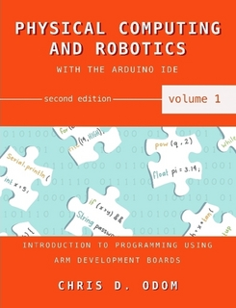
Physical Computing & Robotics Volume 1
Therefore: Physical Computing & Robotics Volume 1.
PC&R Vol 1 teaches active learners how to write code for the Teensy 3.2 and Arduino Due embedded controllers. Essentially, it is a C-language programming textbook for the complete beginner.
370 pages, 100’s of easy-to-follow code examples, 400+ images, 500+ Challenge Problems
Notes:
Students were involved in the process of all Chris’ books. Cover art, photography, clip art, and especially editing.

Slide 62
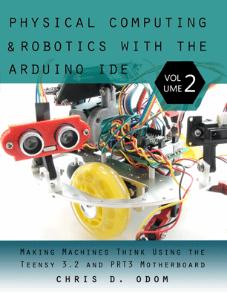
Physical Computing & Robotics Volume 2
Early thinking: Volume 1 teaches students how to program through active learning, so students will then learn about electronics and robotics through lecture.
Again, this was a disaster, so a new book was a necessity.
Chris wrote Physical Computing and Robotics, Volume 2, which covers the hands-on electronics, mechanics, and robotics aspects of the course.
560 pages, 100’s of easy-to-follow code examples, 750+ images, 450+ Challenge Problems

Slide 63
Our Philosophy
Almost no lecture. Students read each book in a self-directed, self-paced manner – with minimum speed limits. Our videos augment the books.
Promotes active learning strategies. Students independently follow the curriculum laid out on our Canvas LMS.
Reading assignments, worksheet, and Challenge Problems for each chapter are given for each chapter with suggested due dates.
We assume all the work will be accomplished in class. Little homework.
If students fall behind, they must do homework or consult with instructors to stay with the group. This is rare but promotes self-regulated learning.
Textbooks (no-lecture) allow students with a variety of skill sets and abilities to be enrolled in the same class.

Slide 64
Our Curriculum
We started developing more a comprehensive curriculum and more sophisticated projects.
We recommend allowing student interests to propel and scaffold the program!
Download our PC&R curriculum files here:
www.pcrduino.com/resources/
We encourage you to use the curriculum, worksheets, and handouts as you see fit. The support materials are free.
Our curriculum, textbooks, and robots are used at high schools, middle schools, and colleges around the world, including Princeton University and Millersville University.
Notes:
For example, in the RGB LED code you experimented with earlier, the while-loop is covered in Chapter 10 and the digitalWrite() commands in Chapter 16.

Slide 65
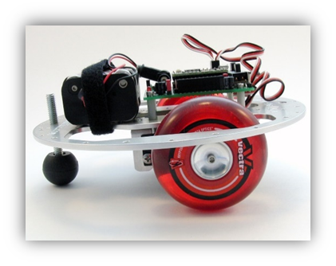
Some Robot Motion: Chapters 18 & 19
Let’s change gears and solve some problems involving robot motion.
Never driven a robot before? No problem! You don’t need a license!
Notes:
Just Chapters 18 and 19.

Slide 66
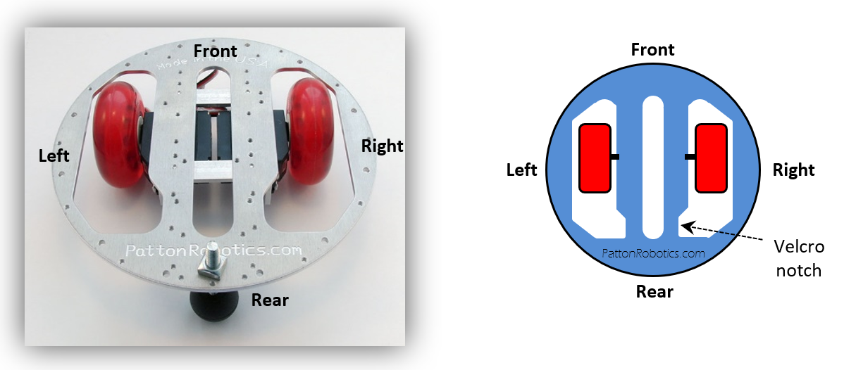
Examine Your robot: The OneBot Orientation
The rear, front, left, and right sides of the OneBot are labeled in both the photograph and cartoon graphic. The terms “left” and “right” refer to the robot’s anatomical reference frame.

Slide 67
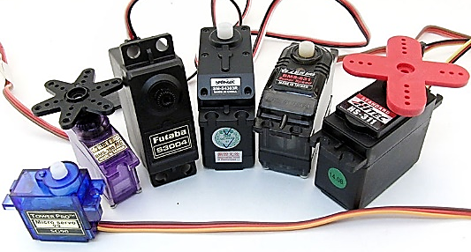
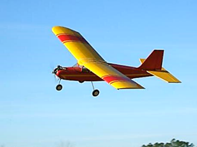
Examine Your robot: The Servomotors
Servomotors (or servos) are electro-mechanical devices commonly found in radio controlled (R/C) airplanes, cars, and boats.
They typically rotate only 180° but provide a lot of torque.
Roboticists modify the servos so they can spin continuously 360°.
We use two SpringRC SM-S4303R servos to propel the OneBot. They are under the robot’s chassis.

Slide 68
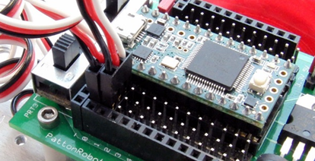
Examine Your robot: the servo connections
The OneBot’s left and right servos are plugged into pin 0 and pin 1 of the PRT_28 motherboard, respectively. Note the cables’ black ground wires are connected to ground pins, which are positioned at the edge of the board.

Slide 69
A Sample Robot Motion Command
Modify your code by entering the following command exactly as it is shown.
displayRGB(50, 0, 50); // dim magenta
robotSteps(40, 1500, 1000);
magentaBlink();
Make sure the new code is placed between the two existing commands, as shown.
Notes:
Don’t forget the semicolon!
Case matters!

Slide 70
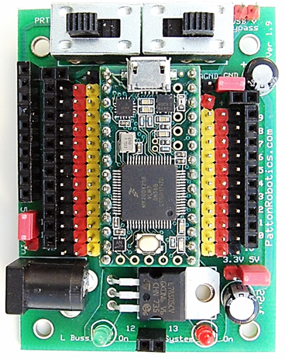
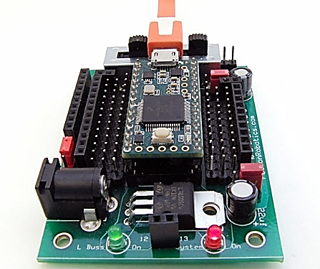
Prepare the Robot to receive the Code
The power to the servos is turned off. Prepare the robot to receive the code using the following steps:
Locate the Auxiliary Power Switch on the left side of the PRT_28 motherboard.
Turn on the Auxiliary Power Switch by sliding it to the right (toward the middle).
Compile and upload the code; watch for the tiny onboard LED to start blinking.
Observe the robot!
Notes:
Chris: this only works when the bypass jumper is in place!!!
Off is when the switch is to the outside of the board.
On is when the switch is push to the inside of the board.

Slide 71
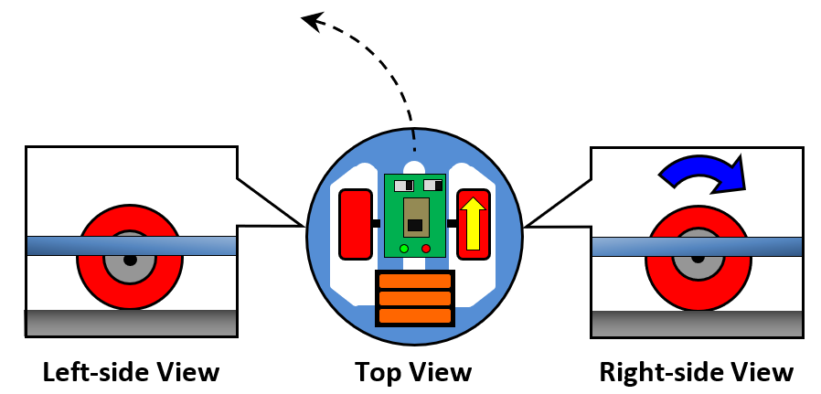
Observe the Robot
If the robot does not move, or if you were unable to carefully observe the robot’s action, leave the switches in the ON-position and re-upload.
The robot should have pivoted to the left and then the RGB LED should have blinked magenta.
The left wheel was stationary, and the right wheel rotated clockwise.
Notes:
Your robot to pivot about the left wheel to the left.
Repeat this until you see the motion of the wheels.

Slide 72
A Little Understanding of robotSteps()
Here is the syntax for the robotSteps() command:
robotSteps(numberOfSteps, leftValue, rightValue);
numberOfSteps is the number of “steps” you want the robot to make.
leftValue and rightValue are numbers sent to the servomotors to make the left and right wheels rotate:
1000 spins the wheel clockwise.
2000 spins the wheel counterclockwise.
1500 stops the wheel.
So robotSteps(30, 1500, 1000) causes the robot to take 30 “steps” with the left wheel stationary and the right clockwise.
Notes:
This is not a built-in command. We made it just for you!

Slide 73
A Quick Explanation about Servo PWM
The numbers 1000, 1500, and 2000, and aren’t magic numbers.
They are pulsewidths, which are interpreted by the servos as positions.
This is known as pulsewidth modulation, or PWM.
1500µs = Stop
2000µs = CCW
1000µs = CW
Servo
Notes:
These pulsewidth values are precisely those used by commercial RC controllers.

Slide 74
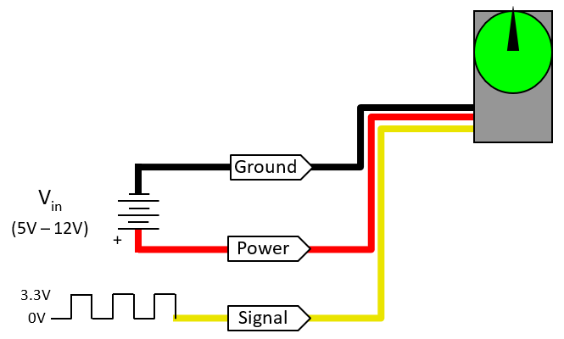
One-Wire i/O
Each servo has three wires:
A black one for ground (outside)
A red one for power (center)
And a white one for signals between the Teensy and the servo (inside)
It is important to plug them in correctly!

Slide 75
Experiment with Robot Motion!
1500µs
STOP
Make the robot move in the following ways. Refer to the diagram for assistance.
Move both wheels 30 steps forward
Move both wheels 30 steps backward
Spin the robot 30 steps left
Spin the robot 30 steps right
2000µs
CCW
1000µs
CW
Servo
robotSteps(30, 2000, 1000);
robotSteps(30, 1000, 2000);
robotSteps(_____, _____, _____)
robotSteps(_____, _____, _____)
robotSteps(30, 2000, 1000);
robotSteps(30, 1000, 2000);
robotSteps(30, 1000, 1000);
robotSteps(30, 2000, 2000);
robotSteps(30, 2000, 1000);
robotSteps(_____, _____, _____);
robotSteps(_____, _____, _____);
robotSteps(_____, _____, _____);
robotSteps(30, 2000, 1000);
robotSteps(30, 1000, 2000);
robotSteps(30, 1000, 1000);
robotSteps(_____, _____, _____);
robotSteps(_____, _____, _____);
robotSteps(_____, _____, _____);
robotSteps(_____, _____, _____);
robotSteps(_____, _____, _____);

Slide 76
Challenge #1
Program your OneBot to move between two pieces of candy. It should start at one of the candies, move to the other piece, and then return to the starting point.

Slide 77
Challenge #2
Program your OneBot to move between two pieces of candy, avoiding an obstacle placed directly between the two pieces of candy.
Optional twist: have your robot move to the obstacle and then travel around it in a square path.

Slide 78
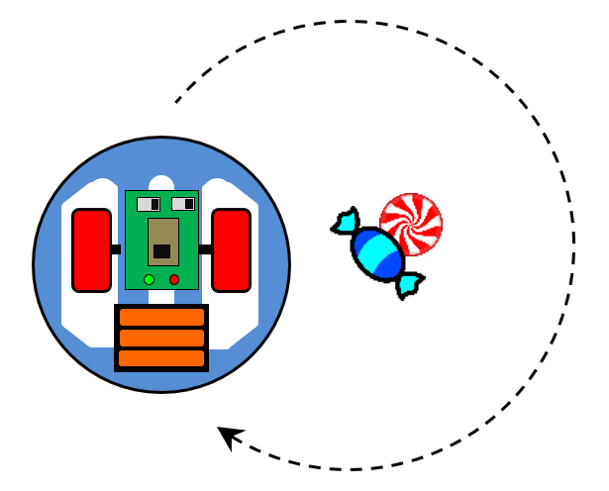
Challenge #3
Program your OneBot to move in a circular pattern around two pieces of candy with a smooth, continuous turn by veering to the left or right.

Slide 79
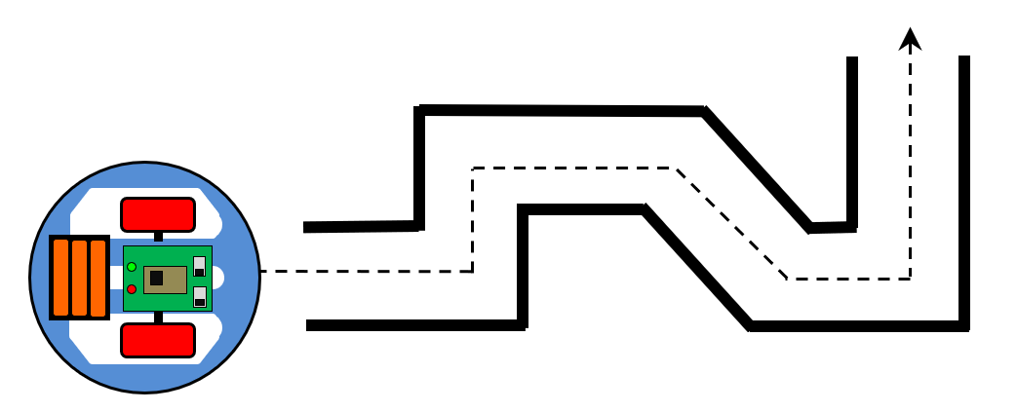
Challenge #4
Program your robot to navigate a simple maze.

Slide 80
Success!
When you have finished with all your coding, enter the following line at the top of your code window like so:

Slide 81
Open the Serial Monitor to View the Output
To view the program’s output, open the Serial Monitor via Tools >> Serial Monitor, or press the Serial Monitor Button, or press CTRL+SHIFT+M.

Slide 82
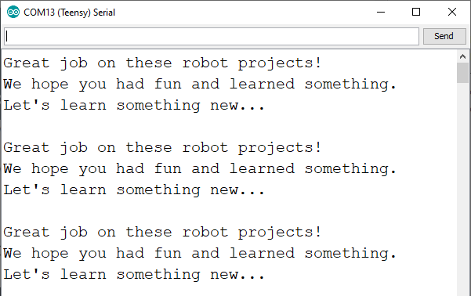
Success!
You should see this message on the screen and the RGB LED fading in and out through the primary colors.

Slide 83
Save your work
Before moving on, save your work. Either by pressing CTRL + S, or clicking on File >> Save, or by clicking on the Save button, as shown.
Notes:
The default location is on the desktop in the EduCon Guest folder. Participants can save their work to a flash drive or email it to themselves.

Slide 84
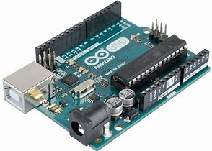
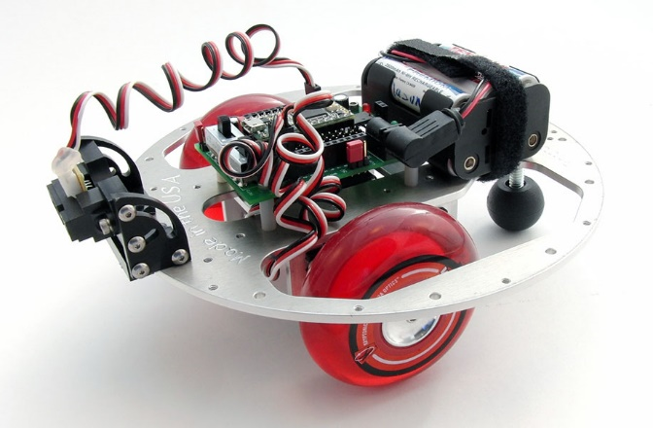
Over the Years: BX-24, Uno, Teensy
Technology changes over time.
First to the market: BX-24, Teensy 2.0, and Arduino Uno
These are 5-volt AVR development boards.
Easy to use and program with a simple IDE.
Patton Robotics developed a PRT motherboard for the Teensy 2.0 and the OneBot for both the Teensy 2.0 and Arduino Uno.
Notes:
Arduino is an Italian company, and PJRC is in the USA.
Arduino is confusing: it is a company, a development board, and an IDE.
AVR = Alf and Vegard’s RISC processor. (RISC = reduced instruction set computer) One of the fiirst to use on-chip flash memory to store programs
IDE = Integrated Development Environment. (Fancy name for programming environment.)

Slide 85
AVR - The Latest Technology
A few years ago, Arduino and PJRC (and others) came out with new, efficient, and fast 3.3-volt ARM controllers.
(ARM stands for Advanced RISC Machines. RISC stands for Reduced Instruction Set Computer.)
Eager to avoid backing a dying technology, we dropped the older 5V AVR systems and now focus on the new Teensy 3.2, Teensy 3.5, and Arduino Due development boards.
ARM architecture is the future! Just two years ago, Apple converted all their phones to ARM processors. (We were four years ahead of Apple!)
Notes:
ARM = Advanced RISC Machines. (RISC = reduced instruction set computer)
9ns processing speeds!
Students were involved in the process of all Chris’ books. Cover art, photography, clip art, and especially editing.

Slide 86
Oh No, no more Uno?
The Uno and Teensy 2.0 are still commonly used today, but the days are numbered for the older 5-volt AVR systems.
It is likely that most schools still use the Arduino Uno in their robotics programs.
These AVR controllers will be supported for a while, but most new devices and sensors are 3.3-volt.

Slide 87
ARM Wins!
For multiple reasons, the ARM architecture is the future:
Improved processing speed
Unbelievable math engine
More efficient (3.3V)
Higher resolution (13-bit practical)
But most importantly: every physical computing device is moving in that direction. It will still viable for many years to come!

Slide 88
Microcontrollers: PIC, AVR, & ARM
Feature | PIC | AVR | ARM
Common Products | Basic Stamp (BS1, BS2px) | Teensy 2.0 Arduino Uno | Teensy 3.2 Arduino Due
Release Date | 1993 (very old) | 2010 (old) | 2012 (new)
I/O Voltage | 5.0 V | 5.0 V | 3.3 V (Teensy is 5-volt tolerant)
Speed | 4 MHz | 16 MHz | 72-96 MHz
Resolution | 8-bit | 8-bit (typical) | 16-bit (13-bit practical limit)
Future Use | Unlikely. | Maybe? | Absolutely!
Flash Memory | 256 Bytes – 16 Kb | 32 Kb | 256 Kb (Teensy 3.2) 512 Kb (Due)
I/O pins (Digital/Analog) | 8-16 | Teensy 2.0: (24/10) Uno: (14/6) | Teensy 3.2: (24/10) Due: (54/12)
Cost | $40 - $79 | $20 | $19 (Teensy 3.2) $45 (Due)
Notes:
Ok to skip

Slide 89
But Which ARM? Teensy 3.2 or Arduino Due?
The Teensy 3.2 and Arduino Due development boards both use the new, super-fast 3.3V ARM controller and both are programmed with the popular Arduino IDE. So which to choose?
Students familiar with Arduino encouraged us to switch to the Arduino Due development board.
Arduino boards are touted as being inexpensive, but the pin configuration is limiting if you want to use inexpensive off-the-shelf components. Otherwise, jumper wires or shields.

Slide 90
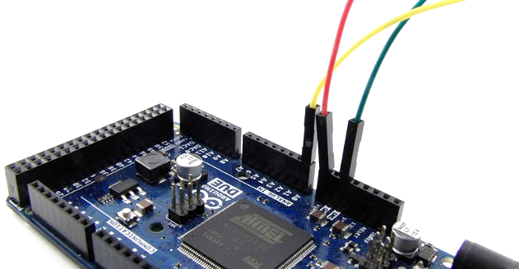
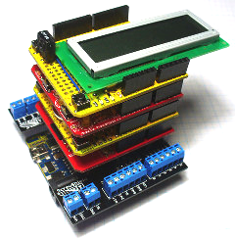
Arduino Due: Jumper Wires and Shields
Jumper wires are cheap and handy but are easily disconnected.
Shields are devices that perform specific functions (e.g., control motors and LCD screens) when attached to an Arduino development board. But they are expensive and consume board space and resources.
Photo credit: John Boxall and www.freetronics.com

Slide 91
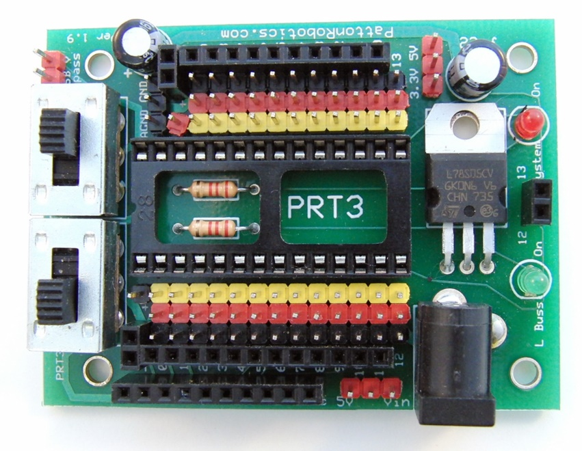
Teensy 3.2 and PRT_28 Motherboard Pros
Inexpensive.
Small footprint.
Huge number of male and female header pin connections.
Plug-and-play with off-the-shelf and homemade components.
Teensy 3.2: pattonrobotics.com/products/teensy-3-2
PRT3: pattonrobotics.com/products/patton-robotics-teensy-motherboard-kit
Notes:
We prefer the Teensy 3.2 controller and PRT3 motherboard for many reasons.

Slide 92
Teensy 3.2/PRT3 Pros
Two power switches (main and auxiliary). Handy!
Replaceable microcontroller. (Students will destroy them!)
Our students build and solder it from a kit. (Most schools don’t.)

Slide 93
Motherboards: PRT3/Teensy vs Arduino Due
Feature | PRT3 & Teensy 3.2 | Arduino Due
ARM Architecture? | ✓ | ✓
Replaceable Microcontroller? | ✓ | ✗
5-volt tolerant I/O pins? | ✓ | ✗
No Shields Required? | ✓ | ✗
Main Power Switch? | ✓ | ✗
Auxiliary Power Switch? | ✓ | ✗
Full Male and Female Headers? | ✓ | ✗
Plug-n-Play Capable? | ✓ | ✗
Direct Bluetooth/RF Comm Plug-In? | ✓ | ✗
Breadboard-able Microcontroller? | ✓ | ✗
DIY Kit Option? | ✓ | ✗
Available Power & Ground pins | 27/26 | 3/3
I/O Pins (Digital/Analog/PWM) | 24/10/10 * | 54/12/12
Footprint | 50 x 68 mm | 53 x 104
Retail Cost | $38-$45 (together) | ~$45
Made in the USA | ✓ | ✗
* For a TON of I/O pins and an SD card reader, consider the Teensy 3.5 and Patton Robotics Motherboard.
Notes:
Ok to skip

Slide 94
Real-World Challenges & Opportunities
The Teensy and other Arduino-based microcontrollers are robust but are not toys and can be damaged if care is not taken.
When the programming cable is plugged in, the microcontroller has power. Be careful that you don’t set it down on metal. Even an itty-bitty staple can short it!
Prevent this by plugging the controller into a breadboard, use standoffs, or attach it to a robot.
Be careful not to pry off the micro USB connector!
Don’t bathe with it.
But with real-world problems come real-world opportunities…

Slide 95
Physical Computing: Sensors
Physical computing is also about gathering information from sensors and other input devices such as keyboards, buttons, and switches.
What we can sense today is incredible: temperature, light, force, flexion, range (distance), rotation, acceleration, magnetic field, voltage, current, moisture, fire, CO, pH, turbidity, conductivity, GPS, infrared, UV, muscle contraction, vision, … the list goes on and on and on.
Sensors are typically inexpensive and often come ready to plug in. However, it is fun to build your own, too!

Slide 96
A few Sensors
Let’s now focus on the sensors attached to your OneBot.
Pushbutton – {detects user’s push; Ch 22}
IR Range Finder – {measures distance; Ch 20}
VDB + Light Sensor – {measures ambient light; Ch 21}
Potentiometer – {measures rotation of a knob; Ch 21}
Magnetic Field Sensor – {measures strength of a magnetic field; Ch 21}
IR Line Followers (L & R) – {detects presence of a reflective surface; Ch 21}
Notes:
Sensors are not calibrated. Textbooks walks you through that process for each sensor.
VDB = Voltage Divider Board
The VDB supports any resistance-dependent sensor such as light (photoresistor), temperature (thermistor), Force, Flex, fixed resistor, etc.
A huge array of sensors are not listed here, but are just as easily utilized by the Teensy.

Slide 97
Making Sense of Sensor Cables
Each of these sensors utilizes a 3-conductor cable to transmit data and provide power to the sensor.
The red conductor (wire) is typically the power wire, and the black wire is typically the ground wire. Power and ground come from the motherboard.
The yellow or white conductor is typically the wire that carries signal data to and from the microcontroller.
Notes:
OK to skip this.
Note how easy it is to plug in to the PRT motherboard.

Slide 98
Sensor + Microcontroller Connections
All signal pins on the Teensy are digital pins and are numbered 0 to 23.
The Teensy has ten analog pins, which are numbered A0 to A9.
“Digital” means the state of the signal pin can either be HIGH (1) or LOW (0).
“Analog” means the signal pin can read a range of values (from 0 to 1023), which correspond to voltages from 0 to 3.3V.
Notes:
OK to skip this.

Slide 99
Playing with Sensors: Open the sensor Sketch
In the interest of time, watch us walk through the different sensors and how the Teensy reads and displays their output.
Watch as we open the sensor file: File >> Open Recent >> SensorSandBox
Notes:
If files are not in Recent, they will be on the desktop in the EduCon Guest folder.
You can close the EduCon_Code_TEMPLATE.ino code window if you want.

Slide 100
Robot Sensor Pin Assignments
To make them easy to reference, we can define the pins that each sensor is plugged with an easy to remember name.
These are treated as variables within the code.
Here, each pin is defined with the integer data type (int).
Notes:
Locate these variable assignments in the code. See lines 21-28.

Slide 101
Robot Sensor Output
We can view the output values from each sensor using a homemade function named printSensorNameLoop(), which requires two pieces of data:
the pin number of your desired sensor
Some descriptive text to be displayed with the output values
As shown in Line #63, data from the Pushbutton will be displayed to the screen along with the word, “Button”.
Notes:
Once again, we made these functions just for you.
The textbooks walk you through the steps to create your own functions!

Slide 102
Compile and Run the Code
Download the new sensor sketch onto the Teensy microcontroller by pressing [CRTL] + U, or by clicking the upload button:
WARNING! Only upload the code ONCE – do NOT double-click!

Slide 103
Open the Serial Monitor to View the Output
To view the output from the pushbutton, open the Serial Monitor via Tools >> Serial Monitor, or press the Serial Monitor Button, or press CTRL+SHIFT+M.

Slide 104
Arrange the Windows
Arrange windows so you can simultaneously see the code window, the Serial Monitor, and the Teensy Loader:
Notes:
This make coding and debugging faster and easier!

Slide 105
the Pushbutton Output
Watch as the values from the pushbutton scroll up the screen. They should all be 1, indicating the button is not pressed.
Press the button and note that the output value changes to 0. Nifty!

Slide 106
the Other Sensor Outputs
We will pause the PowerPoint here and walk you through the remaining sensors, displaying data from each to the Serial Monitor.
If you want to explore on your own, that’s fine. Just comment-out the line of code for the sensors you do not want and uncomment the line of the sensor you do want.
We set it up to only display one sensor at a time.
To quickly comment/uncomment an entire line, click on the line of code and press CTRL + /.

Slide 107
Output to the LCD Screen!
We do not have to be tethered to the computer to see the output from each sensor! We can use another homemade function named LCDSensorNameLoop() to display the sensors’ output to the LCD screen!
All other lines of code above it must be commented-out.
As shown in Line #75, the value from the Potentiometer is printed to the LCD along with the word, “Pot”.
Notes:
Once again, we made these functions just for you.
The textbooks walk you through the steps to create your own functions!

Slide 108
Potentiometer Output to the LCD Screen!
The three images below show the potentiometer knob in three positions:
Full counterclockwise
Middle position
Full clockwise
Notes:
Try it yourself!
CW and CCW may be different on your board.

Slide 109
Graphical Output!
Finally, we can use the Serial Plotter to graphically display data from one or more sensors! This is great for viewing real-time data!
The homemade function named sensorGraphPlotter3() displays data from three sensors to the Serial Plotter!
All other lines of code above it must be commented-out.
As shown in Line #81, the values from the IR Range Finder, the Light Sensor, and the Potentiometer are graphically displayed to the Serial Plotter.
Notes:
Once again, we made these functions just for you.
The textbooks walk you through the steps to create your own functions!

Slide 110
How to Display Graphical Data with Arduino
View the graphical output of the three sensors with these steps:
Upload the code.
Note data from the three sensors are printed to the Serial Monitor. (Along with max and min limits.)
Close the Serial Monitor.
Open the Serial Plotter:
(Tools >> Serial Plotter)
Notes:
The output must be comma delimited numerical data only.
No text, just numbers.

Slide 111
Graphical Display of Multiple Sensor Values!
Sample graphical output from the IR Range Finder, the Light Sensor, and the Potentiometer:
Max Limit (1050)
IR Range
Potentiometer
Light
Min Limit (0)
Time →
Notes:
Try it yourself!

Slide 112
Demos
Josie’s Bunny (1st year)
Annie’s Tic-Tac-Toe A.I. Robot (1st year)
Josie’s Bunny (1st year)
Fire fighting robot (Andrew, Sam, Robin, Ian )(1st year)
At Trinity in 2019, theirs was the #1 high school team in North America and #4 in the world
And #10 worldwide including college and professional teams
3D-printed line follower
Drawing Robot
Notes:
Firefighting robot was #1 in North America high schools, #

Slide 113
Evolution of GS Robotics: The Early Course
Slow accumulation of gear. Bits and pieces; dibs and drabs.
Be patient and mindful of the money! Buy high quality stuff!
McMaster-Carr - for all of your hardware and mechanical needs!
Patton Robotics – best bet for robotics educational products!
Adafruit Industries
Sparkfun
RobotShop
Pololu
The more stuff, the more diverse the lessons and the better the student projects.

Slide 114
GS Robotics Today
Year-long course. Three sections.
Each student has their own OneBot and toolbox.
Lab skills:
Soldering – practice boards, small circuits, PRT3 Motherboard
CAD, 3D Printing, and Laser Cutting
Machine tools
Students purchase their own Teensy, PRT3, and batteries. For an additional $12 they can leave with a 3D-printed or laser-cut robot.
Volumes 1 & 2, then Independent Projects.
Competitions and an Open House

Slide 115
Robotics budget
My budget is quite limited. Practically the same as it was in 2002 when we taught four physics classes and one desktop programming course.
With about the same budget, we now cover the expenses for 12 Physics classes, 3 Robotics classes, and Independent Study projects.
Again, we are patient (dribs and drabs), good with money, and buy quality stuff that lasts.
Robotics students purchase their own textbooks, motherboards (and solder them), Teensy 3.2 microcontrollers, and battery pack. (Physics students are not charged a lab fee.)
Notes:
They only buy one Teensy, unless they destroy several.

Slide 116
Robotics Course Dynamics 1
Students enroll at the Intermediate or Intensive level. All in the same class, so changing levels is easy.
Intensive students have about 30% more Challenge Problems to solve, have a few more pages to read in the texts, and are not allowed to “borrow” code from the Internet or another student.
Students submit work three ways:
Worksheets (by hand or electronically via Canvas LMS)
Code and code output is saved as a Word document and submitted electr5onically via Canvas. Can be graded by hand or with rubric.
Visually by instructors. E.g., verify that robot follows a line or stays on a table.

Slide 117
Robotics Course Dynamics 2
As soon as work is submitted, students may proceed to the next chapter.
Grading Robotics is still confusing to us. Easier early on: syntax issues, comments, bad variable names, submitted on time, etc. But we allow students to keep working until it works. They should check that the output is what is expected. If it is, how to grade? How to grade art? Suggestions?
Most of our students do well with this independence. Some with reading comprehension/speed issues might struggle a bit, but consultations help here.
Even students with severe learning differences can succeed if the scope of the course is further narrowed for them.

Slide 118
Lab Space
FISHBOWL Classroom
Programming desks
Toolboxes
Whiteboard and Clevershare boards
Notes:
Fabrication and Integration of Software and Hardware Bot Operations Workshop Laboratory

Slide 119
Lab Space
FISHBOWL Lab
Soldering stations
3D Printer (from kits)
100-W Boss Laser Cutter
Drill press
Toolbox
Raw materials
Advanced Science Lab and Robotic Arm Lab
https://www.youtube.com/watch?v=1uZ1uDm9kYQ
Notes:
Fabrication and Integration of Software and Hardware Bot Operations Workshop Laboratory

Slide 120
Lab Space
Notes:
Fabrication and Integration of Software and Hardware Bot Operations Workshop Laboratory

Slide 121
Fabrications Lab Skills
CAD Tutorials
SketchUp
eMachineShop
Repetier
RDWorks (PC only)
Laser Cutter intro: nameplates for toolbox shelves.
3D Printer intro: decals for toolbox identification.
Circuit Board Design and Fabrication
ExpressPCB (PC only)
Notes:
Order textbooks Day 1 (students choose B&W or color, paperback or spiral) and then we do lab skills for a week until they arrive.

Slide 122
Solder Lab Skills
Practice on sacrificial PCBs
Build two small but useful circuit boards. Patton Robotics provides boards or we make our own with ExpressPCB.
LEDs
RGB LEDs
Piezo
Pushbuttons and Switches
Line Followers
10 segment LEDs
Potentiometer boards
VDBs
Voltage probes
Hall effect probes
Etc.
PRT3 Motherboard
A big build with a few hundred solder joints
Notes:
The program grows!
Student evaluation of PRT3 solder joints

Slide 123
3D Printing
We prefer the DIY kits
Great experience for students to assemble
Easy to replace/repair
Inexpensive (especially DIY kits)
Requires careful attention and routine alignment
Have spare parts on hand
Limit filament colors
Requires CAD (SketchUp, Tinkercad, Solidworks, AutoCAD, etc…)
Requires 3D Printer Host Program (Repetier, MakerWare, etc…)

Slide 124
Laser Cutting
Very happy with our Boss LS-1630
Can not cut metal. (Our Arts department has the LS-2436, which does cut steel sheets.)
Expensive (LS-1630: ~$10K. HS-2436: ~$15K)
Requires some routine maintenance
Proper setup is critical – don’t go it alone
Super easy to use; flawless; cutting edge technology (ha, ha)
Suggest 2D drawing CAD (SketchUp, eMachineShop, e.g.)
Requires Laser Host Program (RDWorks, e.g.)

Slide 125
Final Projects 1
With luck, students finish their course work (Volume 1 and 2 assignments) by March.
The final 10 weeks of the year is then reserved for students to work on their final projects.
These can be any robotics, coding, design/art project of their own choosing. Projects must be approved.
Students may work in pairs, but they usually work alone.
The final project concludes each year with the Annual Robotics Open House the Monday before graduation. This is open to the public and is well-attended.

Slide 126
Final Projects 2
We are continually impressed with the quality of the work of these first-year students. Here are some from recent years:
Robin’s Hacked Drone: https://youtu.be/PNxd8gKY8LY
Amerley’s puppet: https://youtu.be/8q33-5_dZc0?t=100
Josh’s LED display: https://youtu.be/6qklIV3SK_4
Logan and David’s Hand-E: https://youtu.be/ka_jA8xFW-s?t=6
Brandon’s Line Recorder/Drawer: https://youtu.be/Vf-b2mwbh-Y?t=51
Megha’s ASL Translator: https://youtu.be/ztrL0UDUxrM
Josie’s pet bunny: https://youtu.be/-LBTJ4MI5DY

Slide 127
Final Projects 3
YouTube Playlists:
2019: https://www.youtube.com/playlist?list=PLGlU0977_w8DGh_JCEgnufhbWwIXbJwhd
2018: https://www.youtube.com/playlist?list=PLGlU0977_w8DTOdADnICMvtoM-GeXEY3-
2017: https://www.youtube.com/playlist?list=PLGlU0977_w8AVil4tN2IP7__fE8HzOClw
2016: https://www.youtube.com/playlist?list=PLGlU0977_w8CLz3W6Cihl_gU5xxZimA2u
2015: https://www.youtube.com/playlist?list=PLGlU0977_w8CP9WWPnHAnrftH6WCPuUid
2014: https://www.youtube.com/playlist?list=PLGlU0977_w8BKCc4ROwWd6d7xIUosirpp
2013: https://www.youtube.com/playlist?list=PLGlU0977_w8AFnANJVMq7_H--0_QG9tLv
2012: https://www.youtube.com/playlist?list=PLEE3F6F71D80D8F80
2011: https://www.youtube.com/playlist?list=PLC38302F6DEF28145

Slide 128
Outside Events
Students are required to attend or compete in at least one Outside Event. This may include:
Trinity College International Robot Firefighting Competition
George School Robotics Invitational Competition
Home Security System
Wooden Binary Reader
Teacher Training Workshops at George School
Admissions Open House Events
EduCon!

Slide 129
George School Robotics Invitational
No prep! Low pressure!
A robotics hack-a-thon. Great way to network.
Show up and solve as many challenges as you can in six hours.
Static and dynamic challenges.
Team and Individuals.
Interested?

Slide 130
George School Robotics Invitational

Slide 131
Some other Coding Opportunities
We’ve barely scratched the surface of what a microcontroller can do. For example, it can also handle traditional (desktop) programming with ease.
Math – { }
Keyboard Input – { }
Logic – { }
Hello World – { }

Slide 132
The Future of GS Computer Science
New projects laboratory with industrial robotic arm: https://www.youtube.com/watch?v=1uZ1uDm9kYQ&list=UU18PG4C1AbRXNfd4lcFGUaw
Continue to involve more students until the diversity of the School is mirrored in the class.
Addition of AP Computer Science Principles?
IB Design Technology
Maker Space(s)?
Break into the 9th grade curriculum?
A 2D/3D Design Thinking & Engineering Course?

Slide 133
Final Thoughts 1
We are lucky. One day, embedded controllers will be the “boring” physics, chemistry, and biology classes of today.
We are lucky that cutting-edge tech is available in high school classrooms today.
We should ride the wave of student excitement while it still fresh and new. The beauty of today’s embedded tech is that both the coding and the electronics are still accessible to the complete neophyte.

Slide 134
Final Thoughts 2
“Robotics” courses evolve. Our course 18 years ago is very different today. What we teach is vastly different. This is less so in our physics courses. How we teach has certainly evolved in both classes, but the material is very different today in robotics. This is due to several factors.
Over time, we have accumulated more stuff. And the more stuff, the more diverse the lessons.
The field is changing. 20 years ago, we were all excited that an embedded controller could even turn on an LED. In college and grad school, Chris spent months building parallel port interfaces to simply read a single voltage value with his desktop computer and to output a voltage with the same machine.
The embedded controller rapidly changed that. Now everyone can do it and do it cheaply!

Slide 135
Kairo’s ethical Dilemma
https://youtu.be/-NCrX8kMbrw?t=45
https://youtu.be/5OiBJ2UivAs?t=81

Slide 136
Take-Away’s
Real coding
Real electronics
Real engineering
Real learning.
Education, not robotics.

Slide 137
Round Table Discussion
Getting students interested
Starting a course
Starting an after school program or club
Setting up a robotics lab
A STEAM curriculum
AP CS Principles
IB Design Technology
IB Computer Science
Textbooks
Competitions
Embedded Controllers in Science Classes
STEAM and other collaborations
Coding, designing, and working with/for the community. People will find you!
Issues and Opportunitiesat your schools?

